Slide 1
Forecasting Sea Surface Temperature using ConvLSTM: CPU vs GPU
Yeshwanth Nanda - RA2211003011973
Jayashree Manigandan - RA2211003012017

Slide 2
INTRODUCTION
Sea Surface Temperature (SST) is one of the most critical parameters in understanding global climate systems, ocean dynamics, and marine ecosystem health. Variations in SST strongly influence atmospheric circulation, monsoon activity, and biodiversity, making accurate forecasting essential for climate modeling, disaster preparedness, and fisheries management. Traditional forecasting methods rely on physics-based ocean models, which simulate thermodynamic and dynamic processes of the ocean–atmosphere system. Although effective, these models demand enormous computational power and are often limited by slow processing speeds, making them unsuitable for real-time applications. With the growing availability of open-source marine datasets, such as those provided by the Copernicus Marine Environment Monitoring Service (CMEMS), there is a clear opportunity to develop faster, data-driven forecasting methods using machine learning. These approaches can learn complex oceanic patterns directly from data, providing accurate forecasts at a fraction of the computational cost.

Slide 3
INTRODUCTION
Background, Motivation & Problem Statement
Deep learning models, such as LSTM and CNN, have shown potential in predicting temporal and spatial trends in environmental data. However, they are computationally demanding, especially when working with large 2D spatial maps.
ConvLSTM (Convolutional Long Short-Term Memory) networks can capture both spatial and temporal relationships in SST data, making them ideal for marine forecasting tasks.
The project implements GPU acceleration using CUDA, cuDNN, and Automatic Mixed Precision (AMP) to demonstrate that SST forecasting can be significantly accelerated without compromising accuracy.
The motivation is to make ocean forecasting more efficient, scalable, and accessible using modern GPU-based computation.

Slide 4
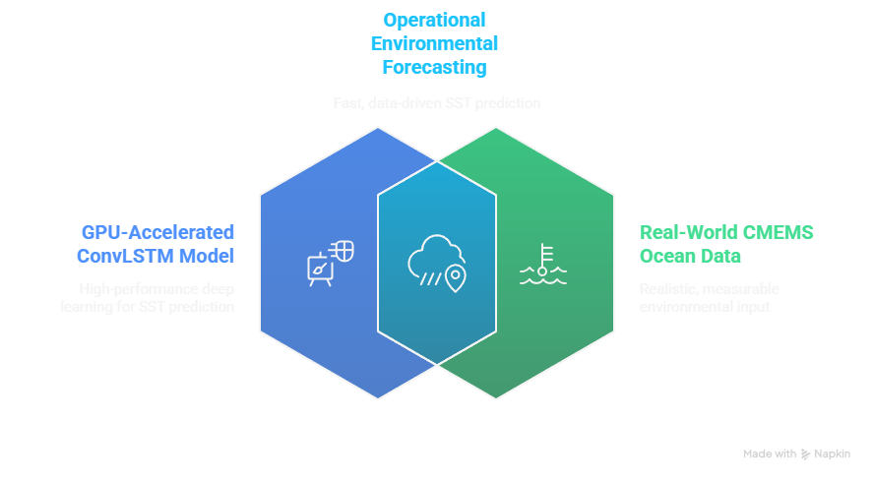
OBJECTIVES

Slide 5
OBJECTIVES
Specific Objectives / Research Questions
To preprocess SST data from Copernicus Marine datasets into structured temporal sequences suitable for ConvLSTM training.
To train and evaluate the ConvLSTM model on both CPU and GPU hardware using identical configurations.
To compare performance metrics such as training time, RMSE (Root Mean Square Error), and memory utilization.
To investigate how GPU acceleration enables scaling to larger spatial grids (e.g., 64×64).

Slide 6
Dataset / API
Copernicus Marine Environment Monitoring Service (CMEMS)
Provides global and regional Sea Surface Temperature (SST) data in NetCDF format. Each file represents daily SST maps at varying spatial resolutions (e.g., 32×32 and 64×64 grids). The dataset offers sufficient temporal coverage to train spatiotemporal forecasting models.
Algorithm
ConvLSTM (Convolutional Long Short-Term Memory)
Integrates convolutional operations with LSTM memory cells to capture both spatial and temporal dependencies. It learns ocean dynamics by observing sequences of SST maps and predicting future states.

Slide 7
Literature Review
Overview of Related Work
Several studies have applied deep learning to SST forecasting with varying model designs and focuses.
Shi et al. (2024) proposed a ConvLSTM model with deformable attention to enhance spatial feature extraction for regional SST, showing accuracy improvements but limited runtime evaluation.
Cao et al. (2025) introduced a feature-granularity-based ConvLSTM approach for long-term SST prediction, extending lead times but lacking GPU benchmarking.
Model–resolution interaction: A few papers stress that model architecture and hyperparameters must be retuned per grid size — performance (RMSE) can vary non-monotonically with resolution. (Result where 32×32 showed CPU advantage in RMSE)
Shi, B.; Ge, C.; Lin, H.; et al. Sea Surface Temperature Prediction Using ConvLSTM-Based Model with Deformable Attention. Remote Sensing, 2024, 16(22), 4126. DOI: 10.3390/rs16224126.

Slide 8
Literature Review
Identified Gaps and Limitations
Existing systems mainly evaluate model accuracy but rarely assess computational efficiency.
Lack of detailed CPU vs GPU comparisons in SST or ocean forecasting literature.
Limited exploration of mixed precision training and GPU memory optimization.
Many models are trained on small, localized datasets and fail to scale to larger regional grids.
This project bridges these gaps by providing reproducible GPU benchmarking and demonstrating practical scalability of ConvLSTM models for real ocean datasets.

Slide 9
METHODOLOGY
Module 1 – Data Acquisition & Preprocessing
Copernicus marine SST data is loaded, cleaned, and structured into NumPy arrays. The dataset is standardized and split into training, validation, and test sets.
Module 2 – Data Preparation
Data is reshaped into temporal grids suitable for spatiotemporal forecasting. Each grid represents sea surface temperature sequences used for ConvLSTM input.
Module 3 – Model Definition
A custom ConvLSTM-based forecasting model is implemented. It includes an encoder–decoder architecture that captures spatial and temporal dependencies in SST patterns for multi-step prediction.
Module 4 – Training & Benchmarking
Models are trained and validated on both CPU and GPU, tracking loss, RMSE, and training time. A multi-grid benchmarking experiment evaluates performance across different spatial resolutions.
Module 5 – Visualization
Comprehensive visual analysis is performed—training loss curves, RMSE trends, and runtime comparisons—to illustrate model performance and hardware efficiency across grid sizes.

Slide 10


Slide 11
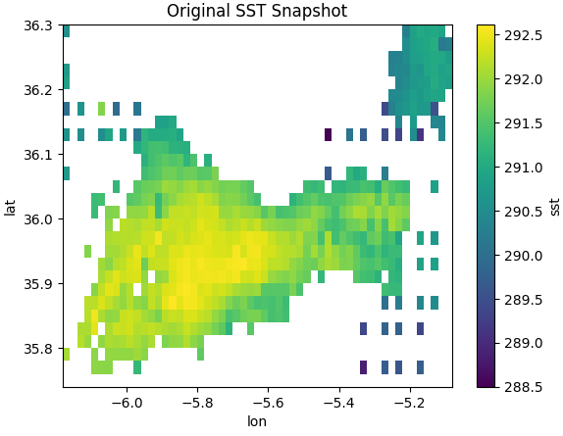
Module 1 – Data Acquisition
This module retrieves SST data from Copernicus datasets in NetCDF format.
Process:
Load NetCDF files using xarray and netCDF4.
Subset specific latitude, longitude, and temporal bounds.
Store extracted arrays for preprocessing.

Slide 12
Module 2 – Preprocessing and Visualization
This module prepares SST data for ConvLSTM input by standardizing its spatial grid, normalizing values, and splitting it into training, validation, and test sets.
Process:
Regrid SST data to a uniform 32×32 spatial resolution using linear interpolation.
Visualize the regridded SST map for verification.
Create temporal sequences with 7 input frames and 1 output frame.
Split data into train (70%), validation (15%), and test (15%) sets.
Apply z-score normalization (mean–std scaling) across all datasets.

Slide 13
Module 3 – Dataset and Model Definition
This module defines the data handling pipeline and the ConvLSTM-based architecture for SST forecasting.
Process:
SSTDataset – Converts SST arrays to PyTorch tensors and structures them for batch loading.
DataLoaders – Prepares training, validation, and test batches; adjusts batch size for GPU/CPU.
ConvLSTMCell – Core computational unit combining convolutional and recurrent operations.
ConvLSTM – Sequentially processes time-series SST frames to learn spatial–temporal features.
ForecastConvLSTM – Integrates ConvLSTM encoder with a 1×1 Conv2D decoder for next-frame SST prediction.

Slide 14
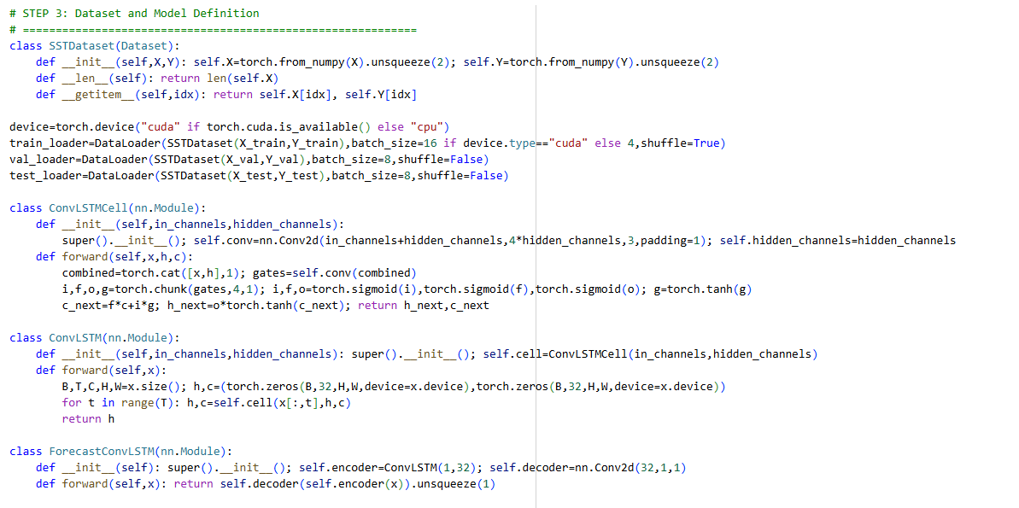

Slide 15
Module 4 – Training and Benchmarking (CPU vs GPU)
This module trains the ConvLSTM model and compares performance between CPU and GPU environments.
Process:
evaluate() – Computes model RMSE on validation/test sets.
train_model() – Trains model for multiple epochs using Adam optimizer and mixed-precision (torch.amp) for GPU efficiency.
Tracks training loss, validation RMSE, and epoch time.
Runs training separately on CPU and GPU to record speed and accuracy differences.
Stores benchmark results in a DataFrame for analysis and visualization.

Slide 16
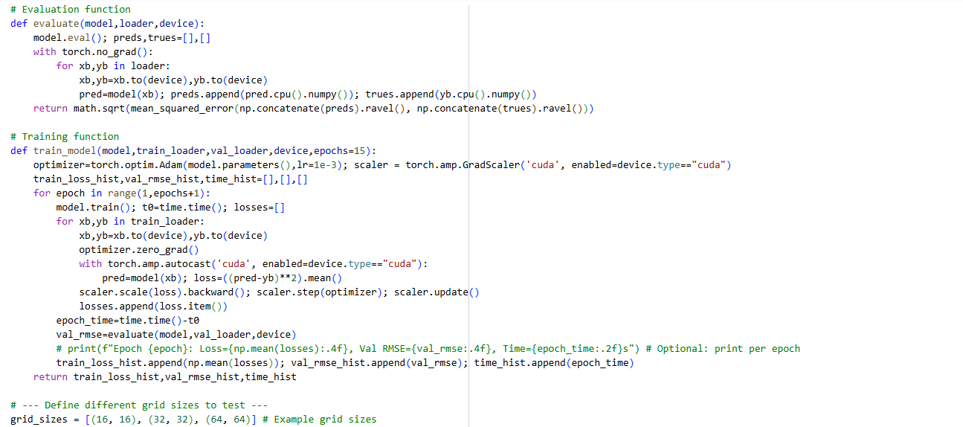

Slide 17
Module 4a – Multi-Grid Benchmarking (CPU vs GPU)
This module evaluates how spatial resolution (grid size) affects ConvLSTM performance on both CPU and GPU setups.
Process:
Reuses previously defined Dataset, Model, Training, and Evaluation functions.
Defines multiple grid sizes (e.g., 16×16, 32×32, 64×64) for comparative analysis.
Performs regridding, normalization, and data splitting for each resolution.
Trains and tests models on both CPU and GPU, recording:
  Training loss
  Validation RMSE
  Execution time per grid and device
Aggregates results into a DataFrame for visualization and cross-grid benchmarking.

Slide 18
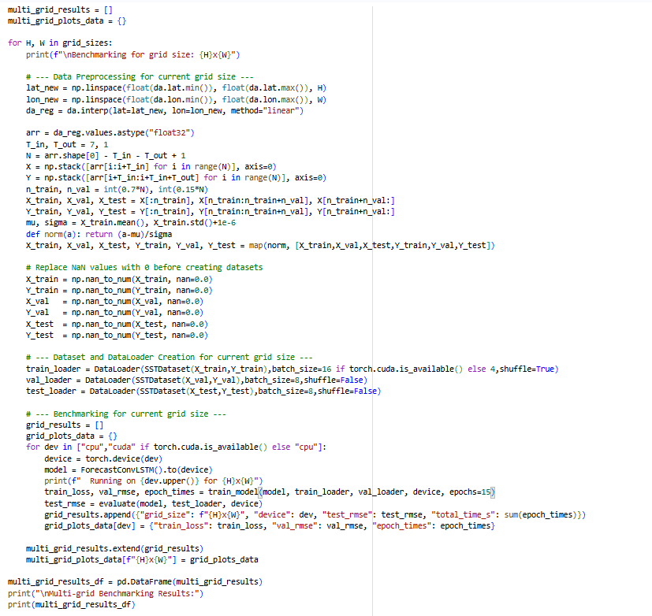

Slide 19
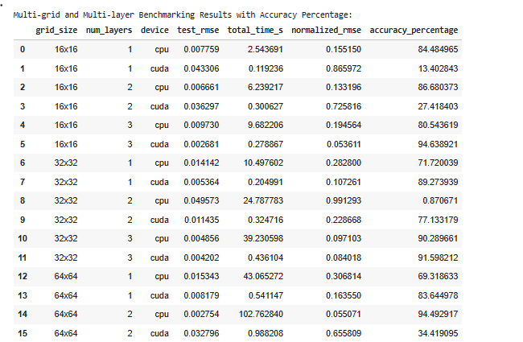
Setup
Grid sizes tested: 16×16, 32×32, 64×64
Number of ConvLSTM layers: 1, 2, 3
Each combination trained for 15 epochs on CPU and GPU.
Evaluation metric: Root Mean Squared Error (RMSE) and Total Training Time (s).
Process
Interpolate SST data to each grid resolution.
Construct ConvLSTM models with varying depth (1–3 layers).
Train and validate each model configuration.
Compare RMSE vs. training time across configurations.
Insights
Higher grid size → better spatial representation, higher computational cost.
More layers → improved learning of temporal features but slower training.
GPU → drastically faster training with similar RMSE to CPU.
Results stored in multi_grid_layer_results_df for analysis.

Slide 20
IMPLEMENTATION
Category | Tools / Libraries | Purpose
Programming | Python 3.10 + | Core development language
Deep Learning | PyTorch (with CUDA, cuDNN, AMP) | Building and training the ConvLSTM model
Data Handling | xarray, netCDF4, NumPy, pandas | Reading and preprocessing Copernicus NetCDF SST datasets
Visualization | matplotlib, seaborn | Plotting SST forecasts and performance metrics
Performance Tuning | CUDA, Automatic Mixed Precision (AMP) | GPU optimization and memory efficiency

Slide 21
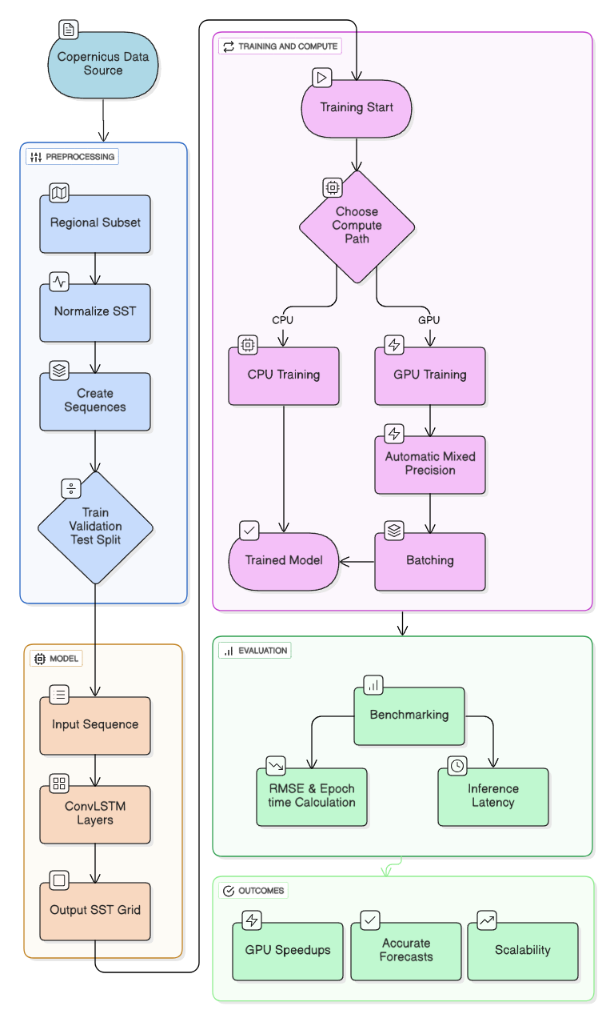

Slide 22
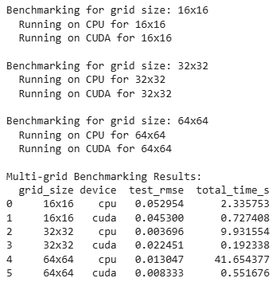
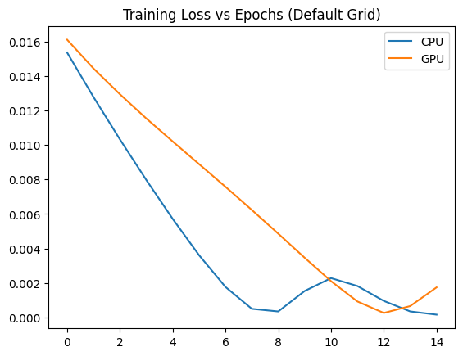
Results and Discussion
This plot shows how the training loss decreases over epochs for both CPU and GPU. Ideally, you want to see the loss decrease steadily, indicating that the model is learning.

Slide 23
Conclusion — GPU Sweet Spot
Sweet Spot: CUDA with 2 ConvLSTM layers and 16×16 grid size
Accuracy: 94.64%
RMSE: 0.00268
Time: 0.27 seconds
This configuration offers the best balance between:
Computational efficiency (speed),
Prediction accuracy, and
Resource utilization.

Slide 24
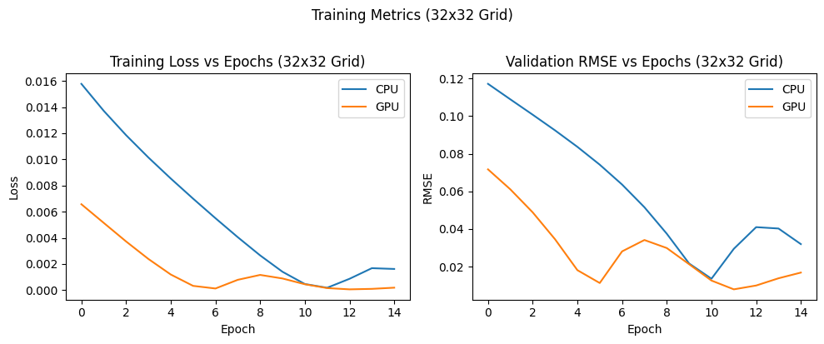

Slide 25
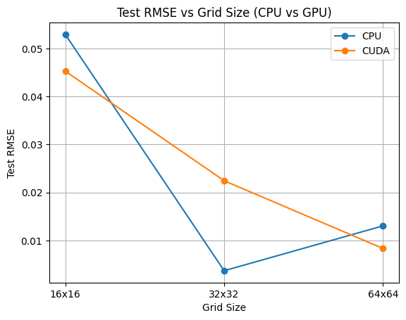
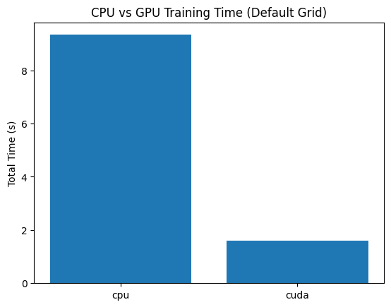
This plot compares the final test RMSE for different grid sizes on both CPU and GPU. It helps to understand how the grid resolution impacts the model's performance on unseen data and how that performance varies between the two devices.

Slide 26
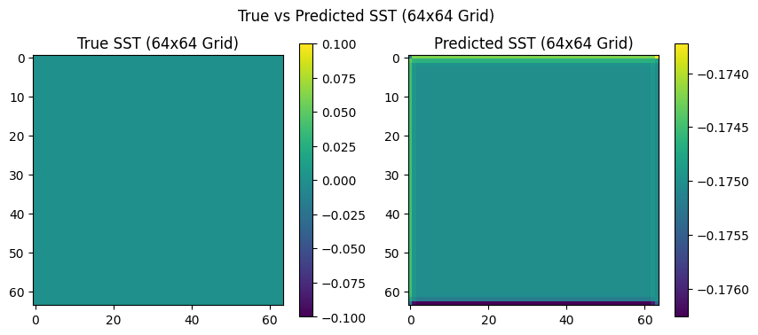

Slide 27
Future Enhancements
Future Scope and Extensions
The current system focuses on daily SST forecasting for a selected regional grid. Future work can expand this to cover larger ocean basins or even global SST prediction.
Additional environmental variables such as salinity, ocean current velocity, and chlorophyll concentration can be integrated to develop a multi-parameter forecasting system.
Incorporating spatiotemporal attention mechanisms or hybrid ConvLSTM–Transformer architectures could further improve accuracy and interpretability.
Model deployment on cloud GPU servers can enable continuous, automated updates and real-time forecasting pipelines.

Slide 28
Future Enhancements
Practical Implementations and Long-Term Goals
Build an interactive visualization dashboard to display predicted SST maps and error statistics.
Develop mobile or web interfaces for oceanographers and research teams to access forecast data easily.
Implement a model retraining mechanism for automatic updates with new Copernicus data.
Optimize the ConvLSTM codebase for multi-GPU or distributed training, allowing it to handle high-resolution global datasets.

Slide 29
References
[1] B. Shi et al., “Sea Surface Temperature Prediction Using ConvLSTM-Based Model with Deformable Attention,” Remote Sensing, vol. 16, no. 22, 2024.
[2] M. Cao et al., “A Novel Method for Sea Surface Temperature Prediction Using a Featural Granularity-Based ConvLSTM Model of Data-Knowledge-Driven,” EGUsphere, 2025.
[3] A. Rawat, “Spatio-Temporal SST Prediction Using ConvLSTM with Koopman Loss,” GitHub Repository, 2023.
[4] C. Li et al., “Long-Term Indian Ocean Dipole Index Prediction Using Deep Learning with ConvLSTM,” DOAJ, 2024.
[5] Z. Xu et al., “A Fast AI Surrogate for Coastal Ocean Circulation Models,” arXiv preprint, 2024.

